Slide 1



Detecting Overlooked High Redshift Caustic Transients in MACS J0416.1-2403
Jakob Perivolotis
Mentor: Dr. Rogier Windhorst
School of Earth and Space Exploration at ASU
AZSGC Symposium, ASU
April 19th, 2025

Slide 2
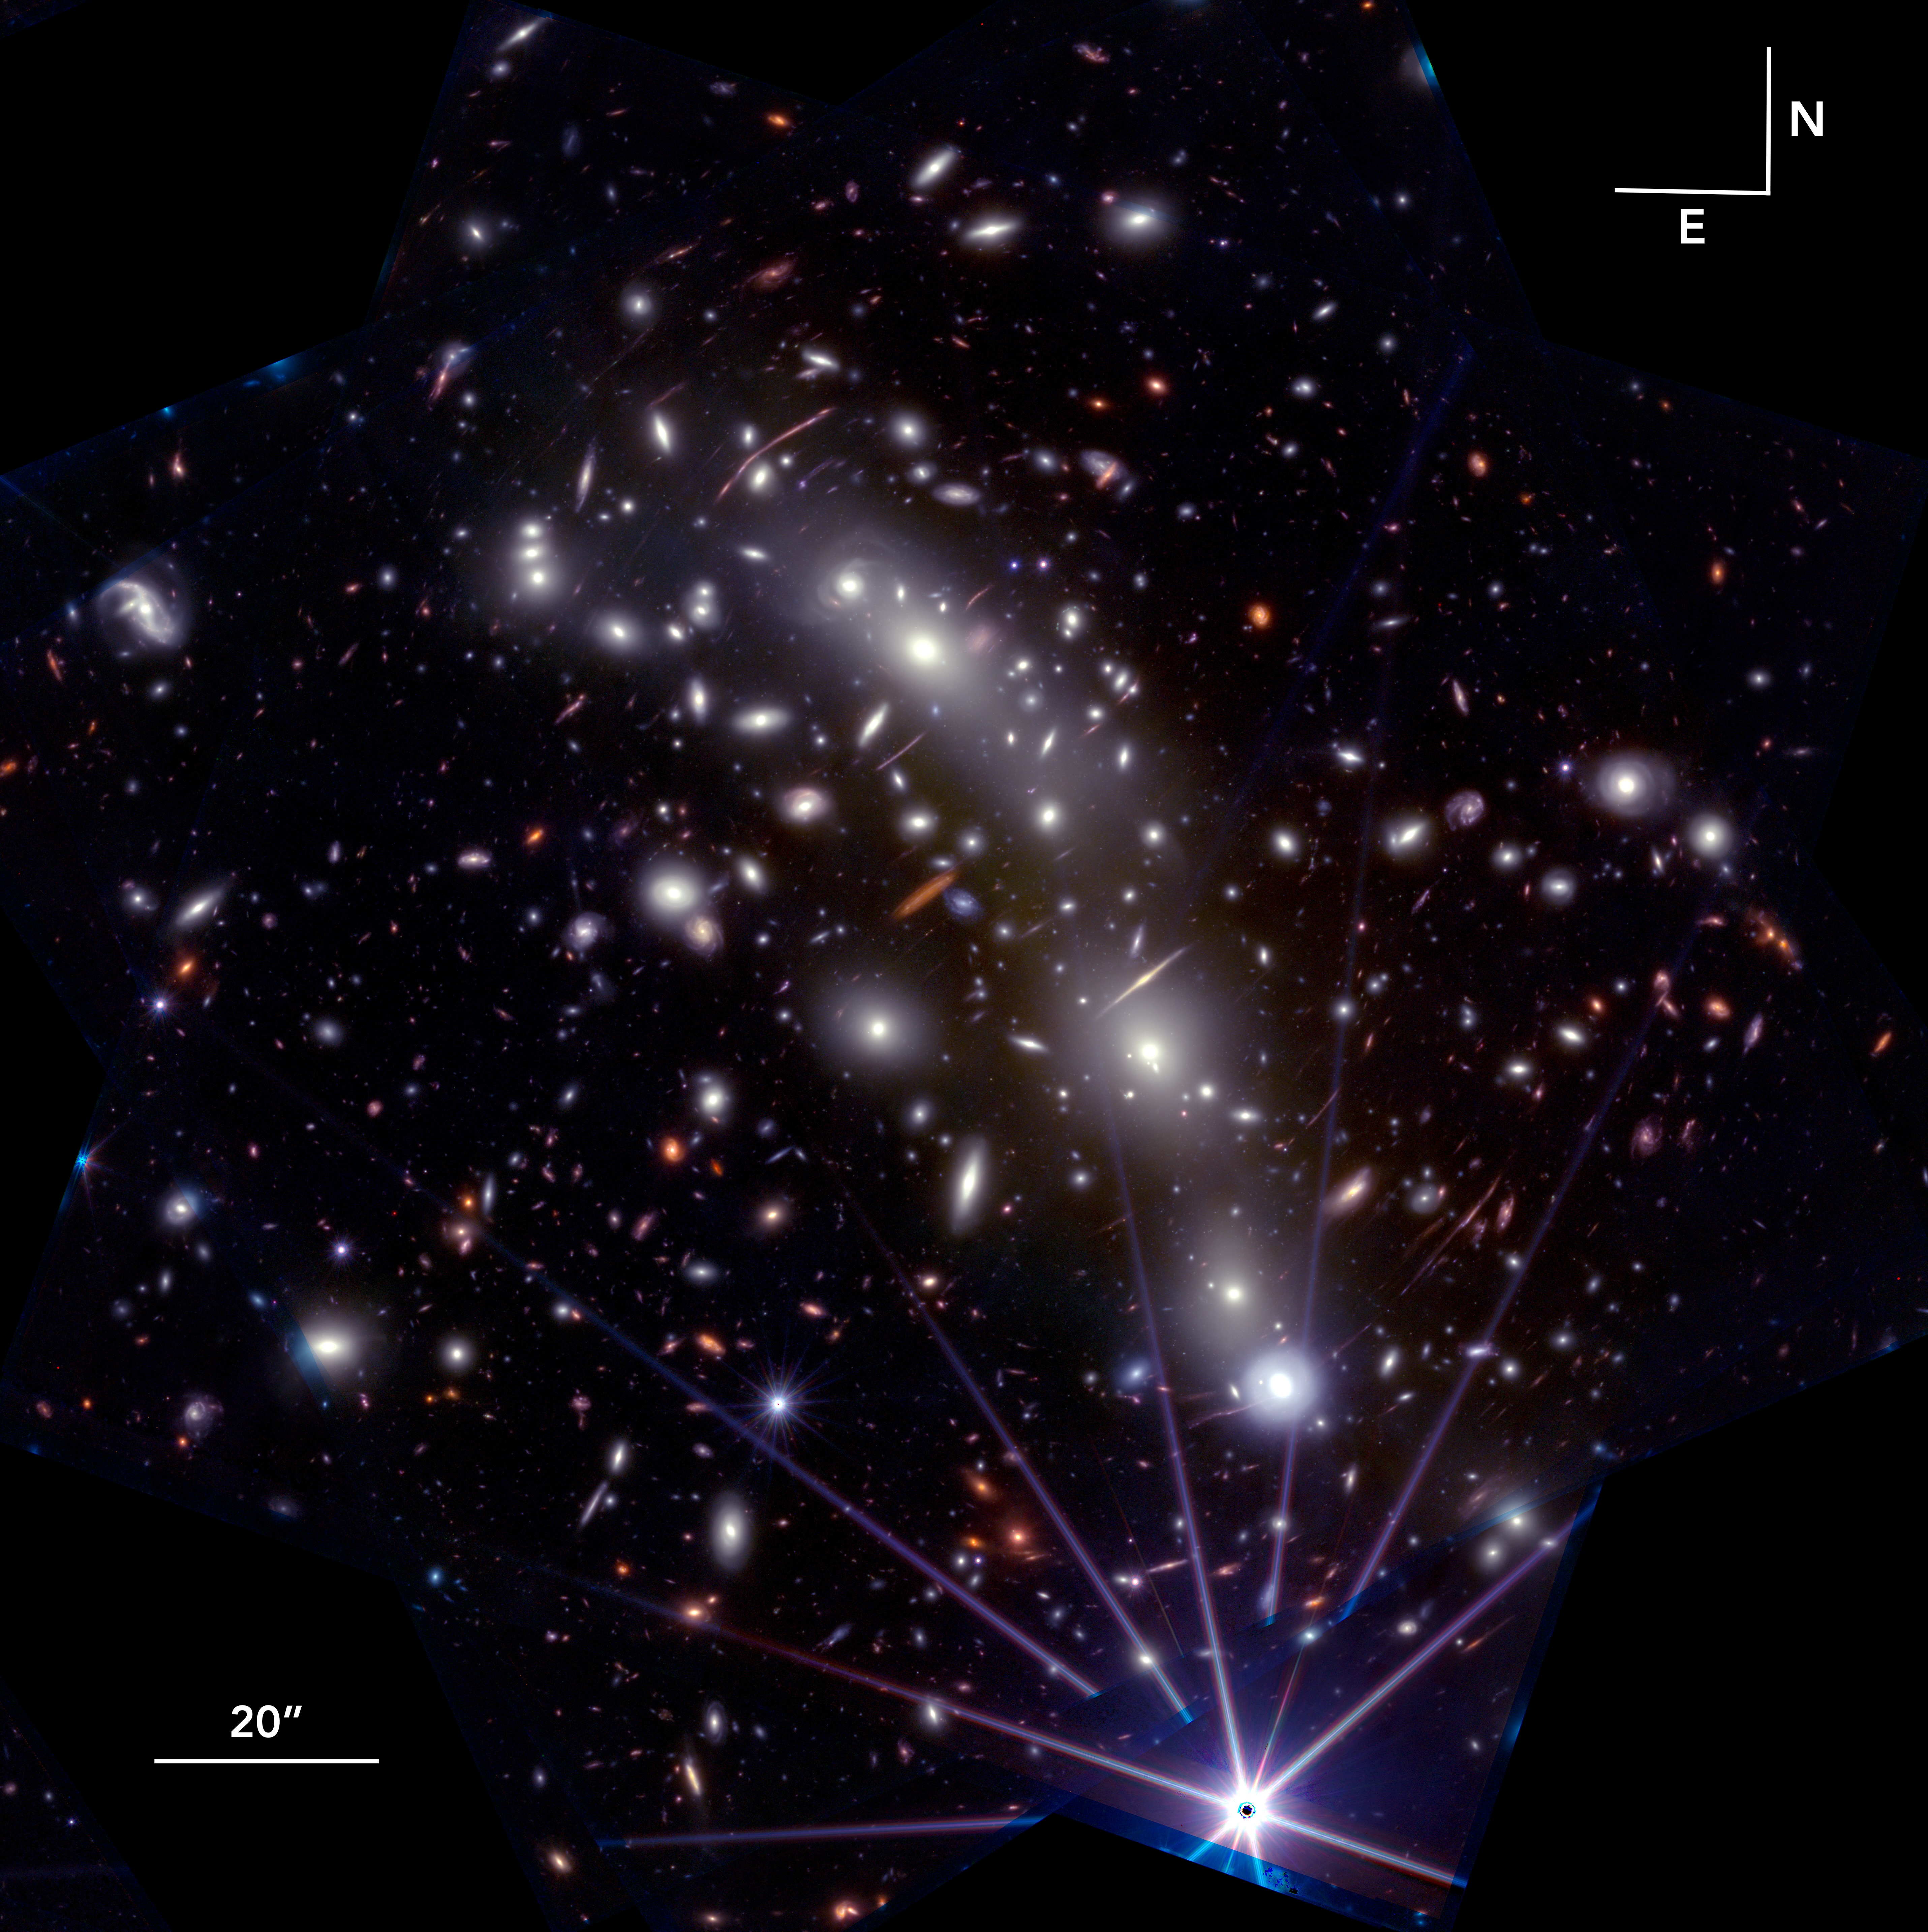
Data:
MACS J0416.1-2403
Redshift = 0.396
8 NIRCam Filters from
0.90μm to 4.43μm
Found in MAssive Cluster Survey (MACS)
Jperivol@asu.edu

Slide 3
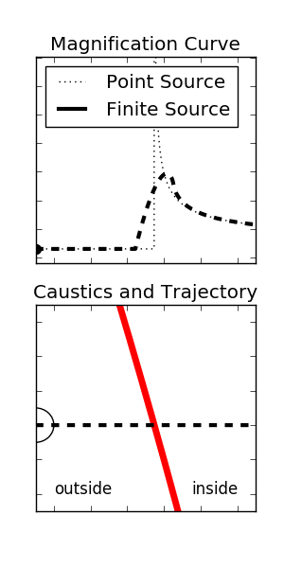
What are caustics?
Regions in the source plane where the magnification coefficient "μ" becomes infinite for a point source.
Caustics map to critical curves in the lens plane.
The first stellar structures in the Universe.
What are we looking for?
Animation by Jennifer Yee
Jperivol@asu.edu

Slide 4
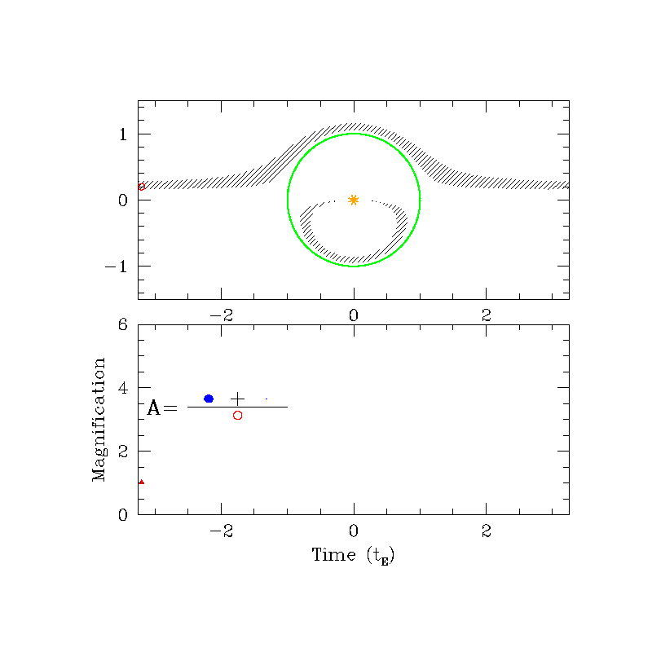
Caustics and Critical Curves
Pink = Radial Caustic
Red = Tangential Caustic
Green = Radial Critical Curve
Cyan = Tangential Critical Curve
Inverted color image of MACS0416's caustics and critical curves for a source at z=6
Animation by B.S. Gaudi
Jperivol@asu.edu

Slide 5
Benefits of Gravitational Lensing
B
Change in apparent magnitude for μ=10^3 is -7.5.
Change in apparent magnitude for μ=10^4 is -10.
Ability to detect sources at cosmological distances.
Amplification map of MACS0416 for a source at z=6 derived from strong lensing model.
Jperivol@asu.edu

Slide 6
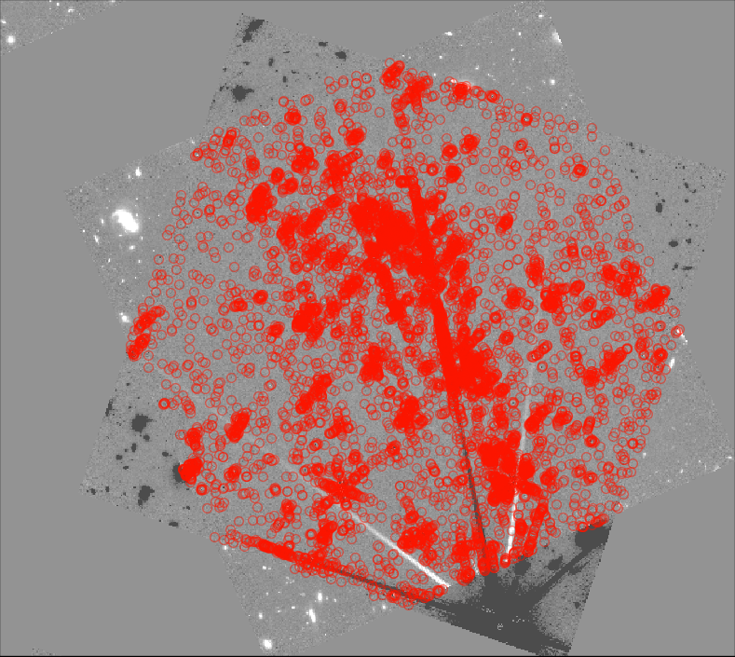
Transient Detection Method
F356W Epoch 3 – Epoch 1 Difference image
Source detection done with SourceExtractor.
Each source was visually inspected to determine its validity.
Thousands of erroneous detections led to laborious visual inspection step.
Jperivol@asu.edu

Slide 7
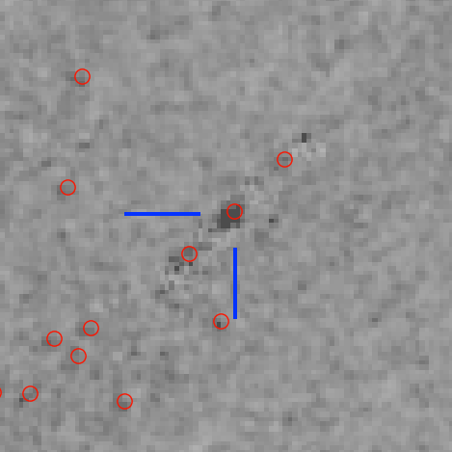
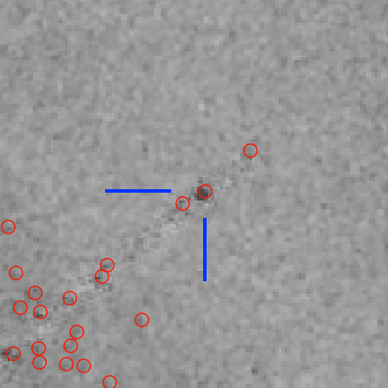
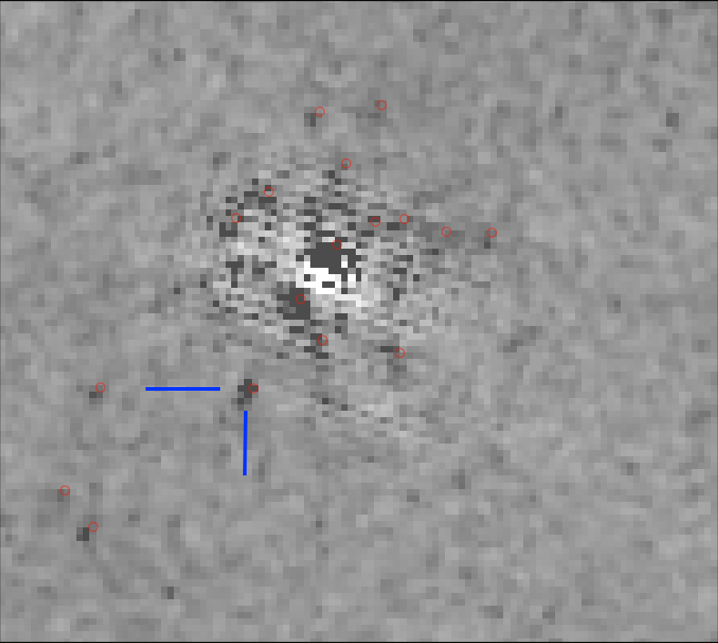
Validation detections
New Detection
Detections
Transient in the “spock” arc
Transient dubbed “Mothra"
Potential candidate
Jperivol@asu.edu

Slide 8
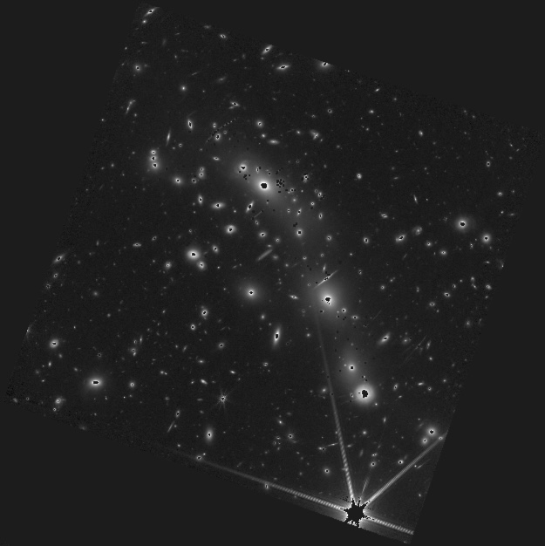
Conclusions, Future work, and Acknowledgments
After analyzing four difference images, no new caustic transits were detected.
This null result constrains the expected frequency of caustic transients per cluster per year.
Thank you, Professor Windhorst, ASU/NASA Space Grant, and Arizona State University.
Jperivol@asu.edu

Slide 9

Thank you!
Jperivol@asu.edu

